Slide 1
UAV Image segmentation
Team Members:
Anand Deshmukh
Asim Banskota
Broti Garai
Leila Hassan
Stevan Halls
Parth Patel
Midhun Mohan
Quianshun Cheng
Vallapakrishna Sreeram

Slide 2
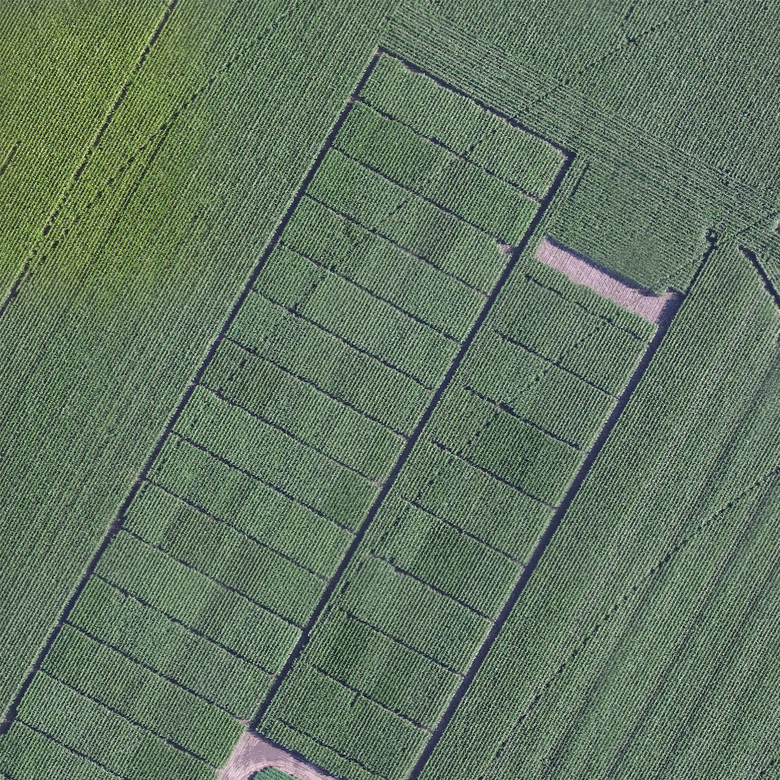

Slide 3
Techniques/Methods
Supervised
Random Forest (pixel based)
Unsupervised
Principal Component Analysis (PCA) and Vegetation Index
Clustering (k-Means)
Watershed analysis
Visual Validation Analysis

Slide 4
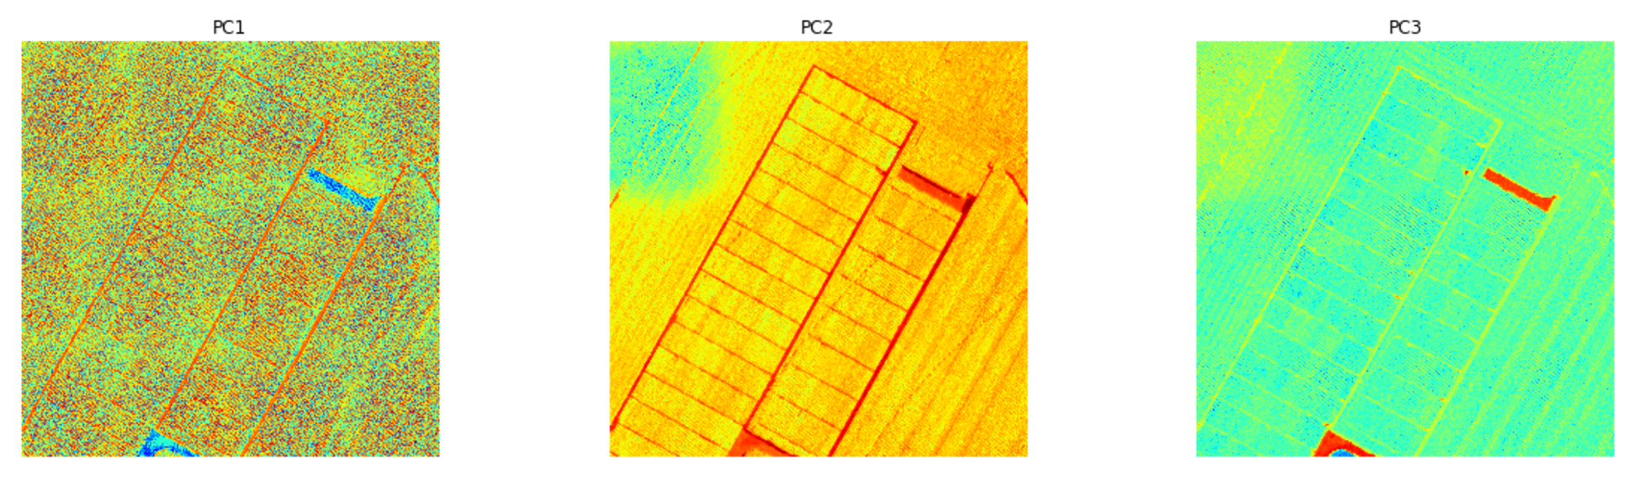
Principal Component Analysis
Original Image
Var. Explained: 97%
Var. Explained: 2%
Var. Explained: 1%

Slide 5
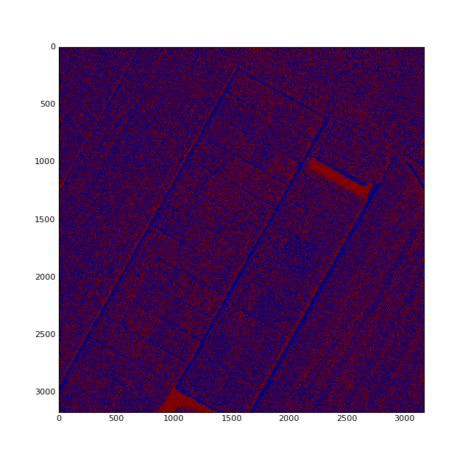
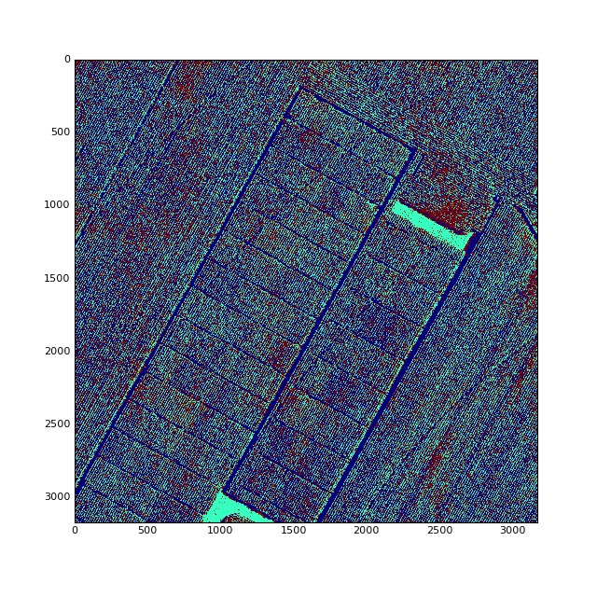
K-means Clustering
PC1, k = 2
PC1, k = 3

Slide 6
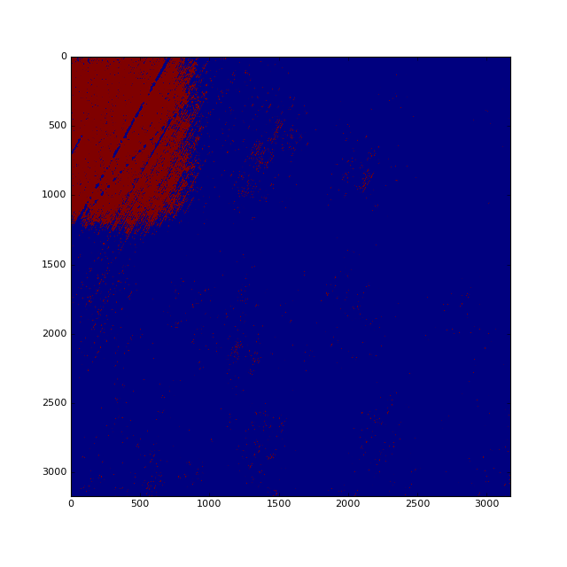
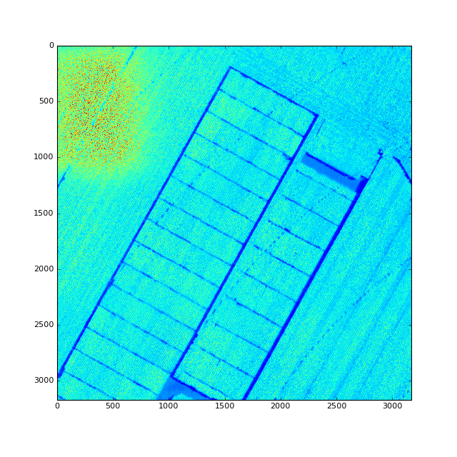
K-means Clustering
PC2, k =2, noisy
k =4, Veg Index Feature

Slide 7
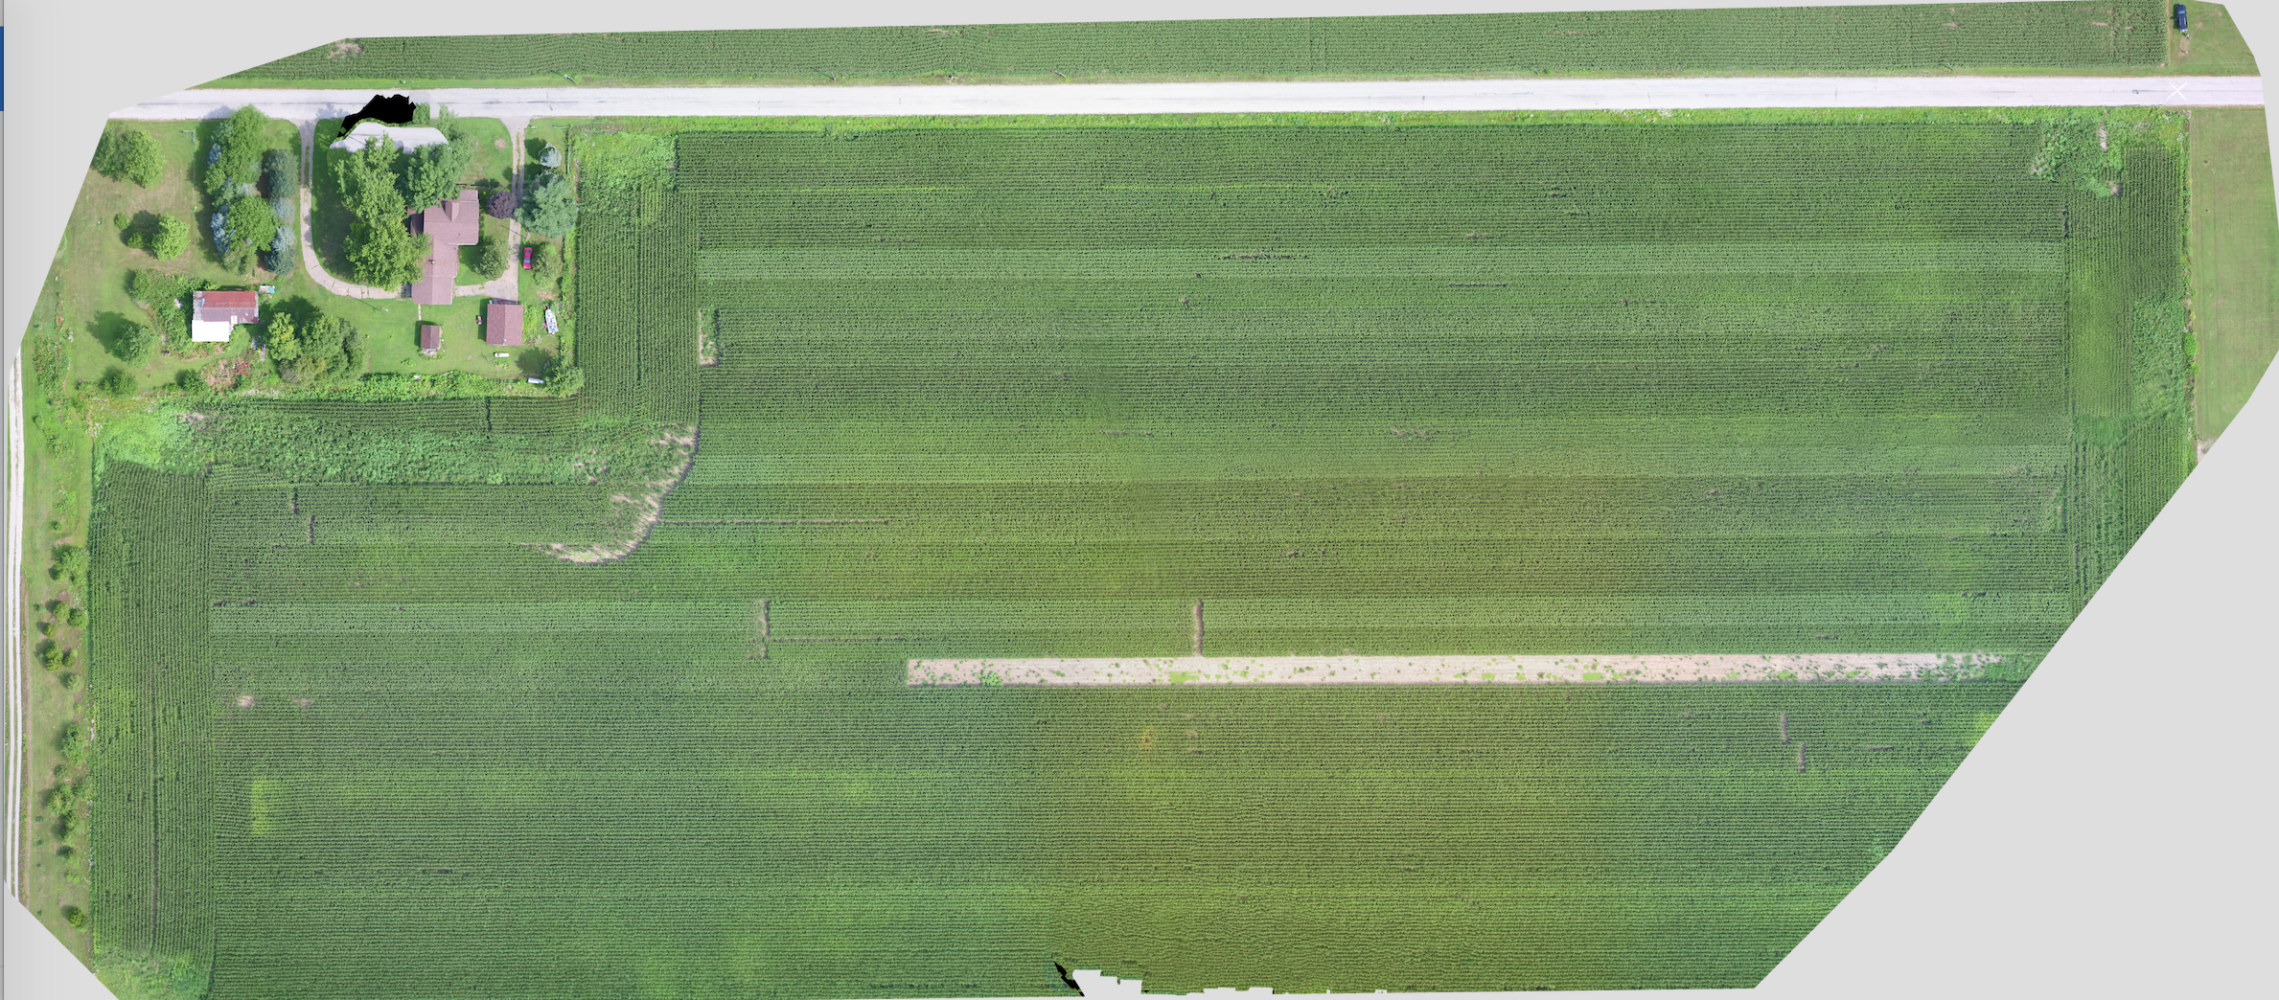
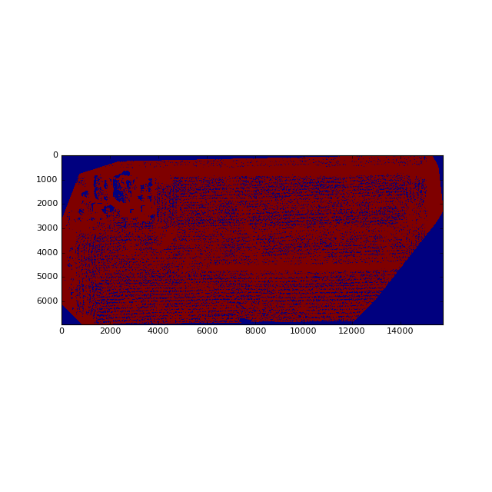
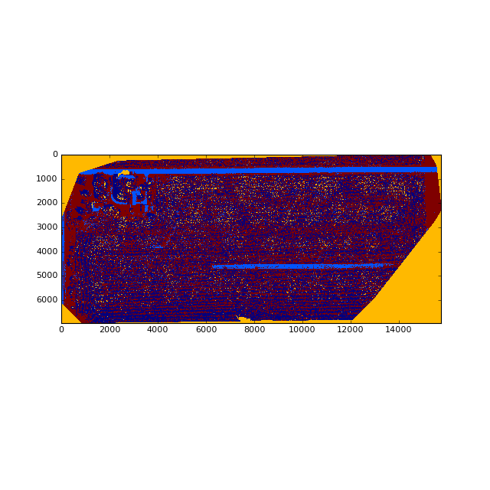
K-means Clustering
PC1, k = 2
PC1, k = 4

Slide 8
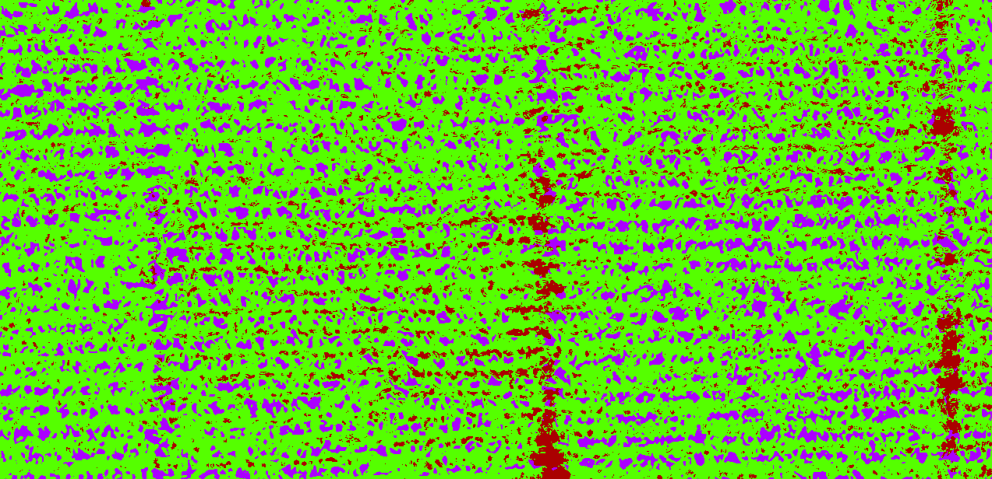
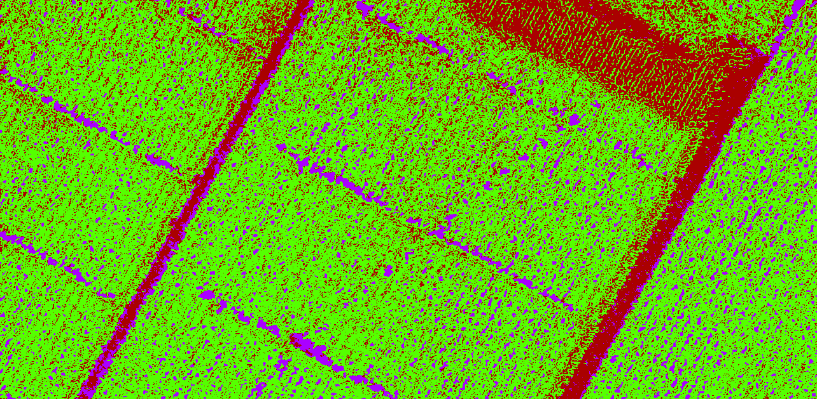
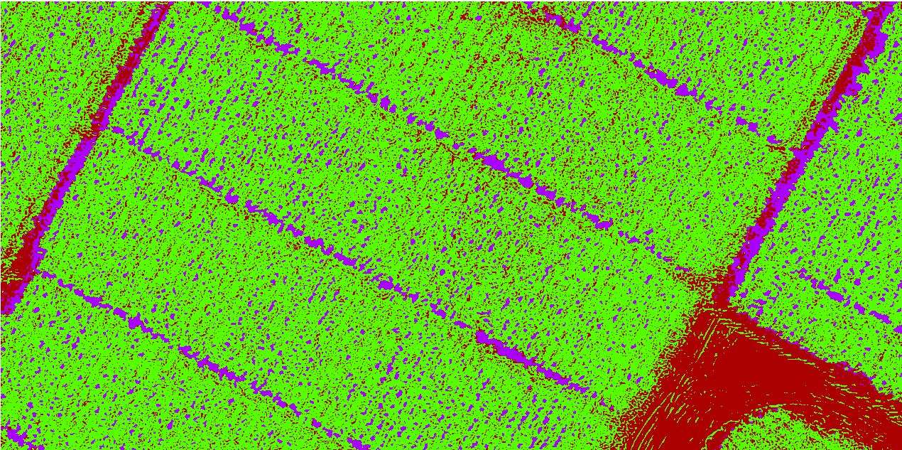
Supervised Pixel Classification (Ilastik Python Module)
Training Set
3 categories
Vegetative
Soil
Shadow
15 regions with ~100 pixels selected
Random Forrest Classifier
Visually Cross Validate across all images

Slide 9
Things we learned !
Domino platform, building models on cloud
Teething problems
Working on teams with diverse skillsets
Image processing, image segmentation
Taught and learned from each other
We succeeded in testing 3 different ways

Slide 10
Hackathon themes we touched upon …
Climate and Monsanto collaboration
Predictive and prescriptive modeling ✅
Data visualization and APIs ✅
Application of Data Science best practices and tools ✅

